Slide 1
“Intelligent Energy Consumption Analytics for Smart Buildings.”
Fundamentals of Data Engineering-24DEA3101
BACH-17
TEAM MEMBERS:
2420030235-CH.SHRAVANYA
2420090031-K.CHARANYA
2420030116-M.SWETHA

Slide 2
Methodology
Data Collection: Gather building energy data (appliances, sensors, weather, environment).
Data Preprocessing: Handle missing values, duplicates, outliers.
Feature Engineering: Extract temperature, humidity, time, appliance usage.
ML Models: Train Linear Regression, Random Forest, XGBoost, CatBoost.
Evaluation: Compare models using MAE, MSE, RMSE, R².
Visualization: Show consumption trends, anomalies, and predictions.
Recommendations: Convert results into actionable energy-saving advice.

Slide 3
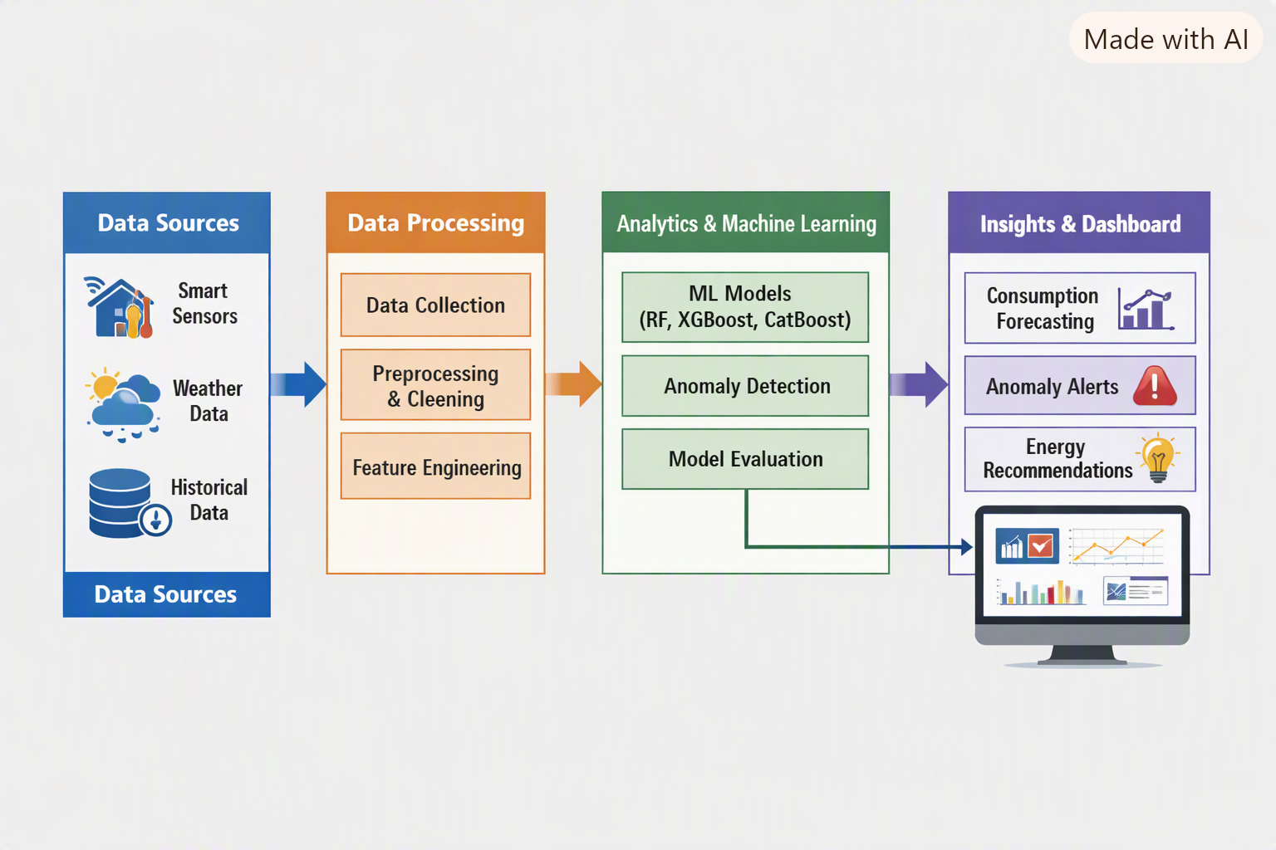
SYSTEM ARCHITECTURE

Slide 4
MODERN TOOLS AND TECHNOLOGIES:
Programming: Python
Data Processing: Pandas, NumPy
Visualization: Matplotlib, Seaborn
ML Frameworks: Scikit-learn, XGBoost, CatBoost
Anomaly Detection: IQR Method
Environment: Google Colab / Jupyter Notebook
Version Control: GitHub

Slide 5
IMPLEMENTATION
Data Ingestion: Load benchmark datasets (Energy Efficiency, Appliances Energy Prediction, ASHRAE).
Data Pipeline: Preprocessing → EDA → Feature Engineering → ML → Evaluation.
Prediction: Forecast appliance energy consumption.
Anomaly Detection: Identify abnormal spikes in usage.
Insights: Highlight key influencing factors (temperature, humidity, time).
Recommendations: Suggest energy-efficient actions.
Interface: Dashboard/visuals for non-technical users.

